Slide 1


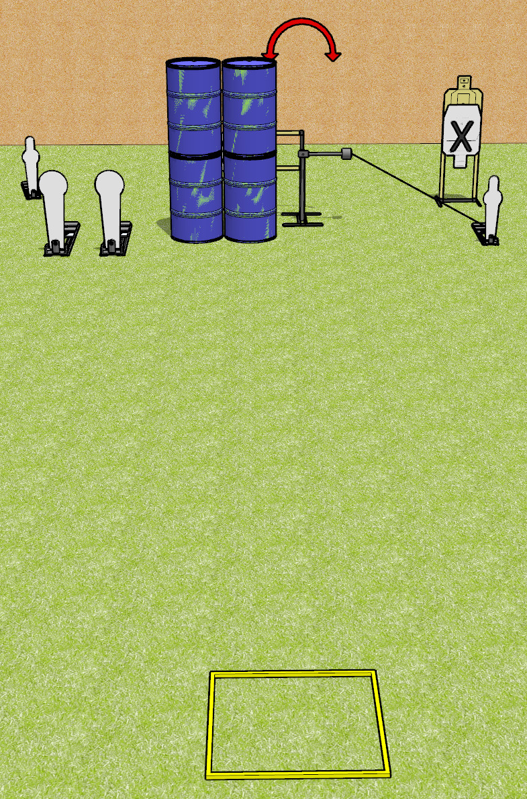
 | Dothan Gun Club – USPSA Match Feel the Need Course Designer : Drew Coleman
Round Count 8 rounds 2 mini poppers, 2 colt poppers 2 USPSA
Equipment List Shooting box Swinger + Activator

Slide 2
Feel the Need
Written Stage Briefing
Feel the Need is an 8 round, 40 point, Comstock speed shoot. There are 2 mini poppers, 2 colt poppers, and 2 USPSA targets. The best 2 hits on paper will score, and steel must fall to score. The start signal is audible.
The swinger is activated by the rightmost mini popper and remains visible at rest.
Handgun start position is in the shooting area, wrists below belt. Handgun is loaded and holstered.
PCC start position is in the shooting area, stock on belt. Loaded carbine is held with both hands, safety on.
On start signal, engage targets from within the shooting area.

